Slide 1
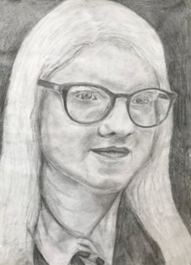
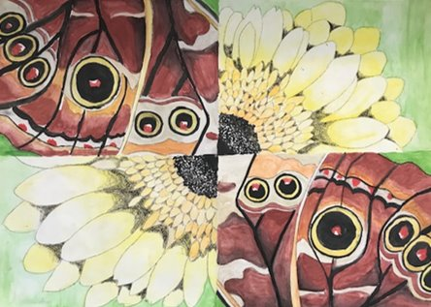
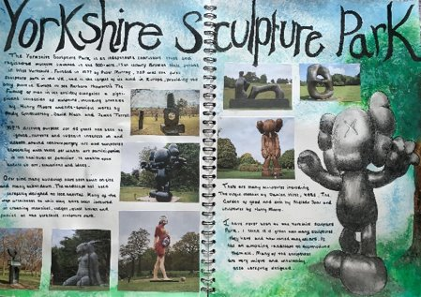
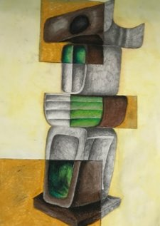
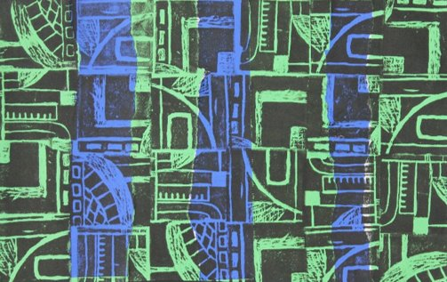
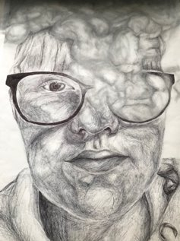
YEAR 9 OPTIONS PRESENTATION
GCSE ART, CRAFT AND DESIGN
Students begin their GCSE coursework in Year 10 and the course is taught over two years following the AQA Art, Craft and Design specification. The course is structured to not only develop the skills that have been taught throughout Key Stage 3 but to also meet the four assessment objectives. Students are encouraged to be independent learners and reflective thinkers, they become confident in taking risks and learn from experience when exploring and experimenting with their own ideas, techniques and processes. They are encouraged to develop knowledge and understanding of art, craft and design in historical and contemporary contexts, through their own exploration of art history and the use of contemporary methods such as Pinterest and Instagram.

Slide 2
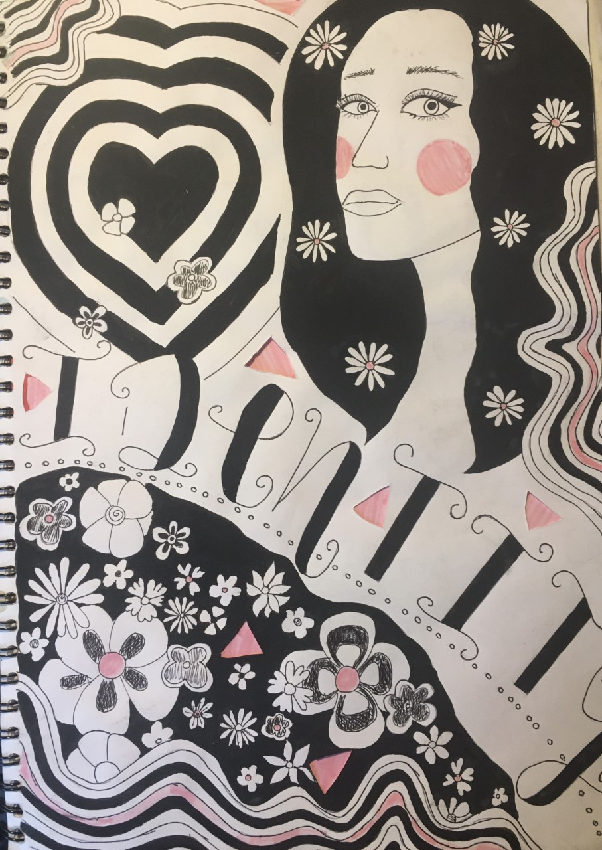
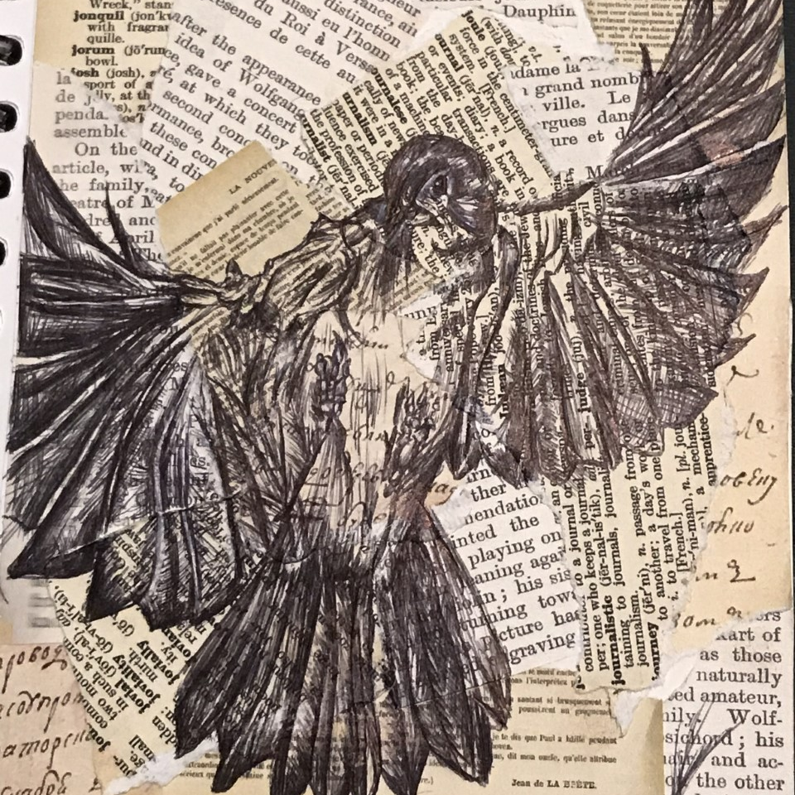
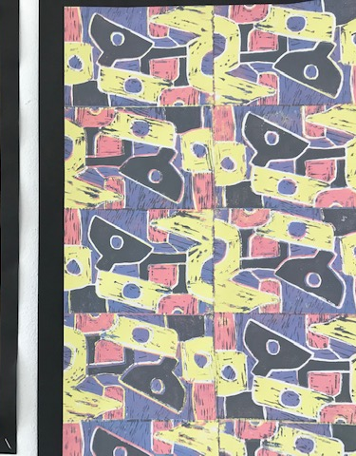
Why should you study Art at GCSE?
“The best part of the GCSE course is that you really get to tap into your creative side which is wonderful because it challenges your mind and let’s you express yourself on paper. It’s also very informative as you get to learn about different artists, their backstories and see their beautiful artwork. You also have a lot of freedom with how you create your work and you can make it look however you feel it should which makes it even better as it’s personal to you and how you do things.” Elena, Year 10

Slide 3
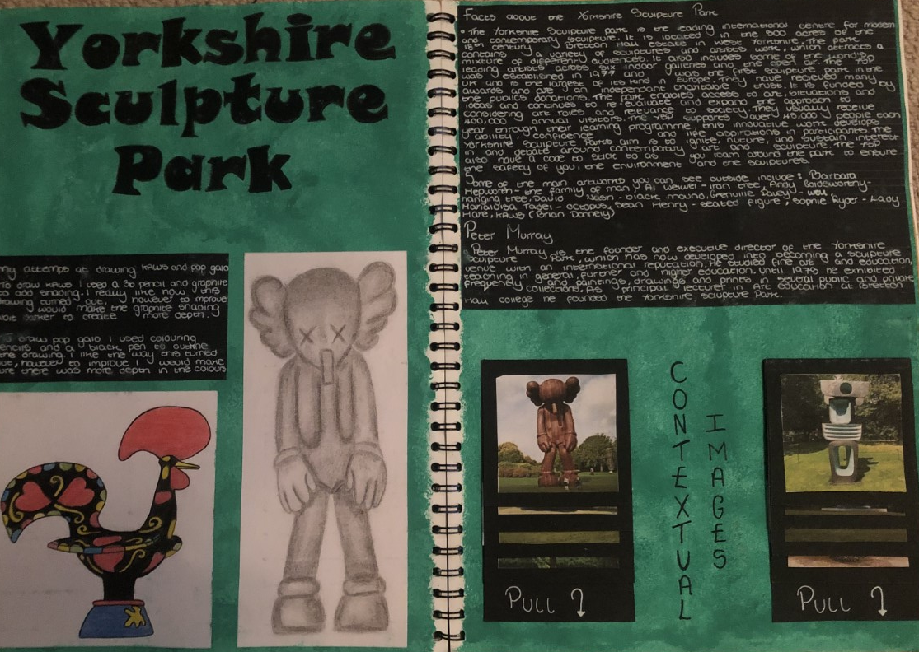
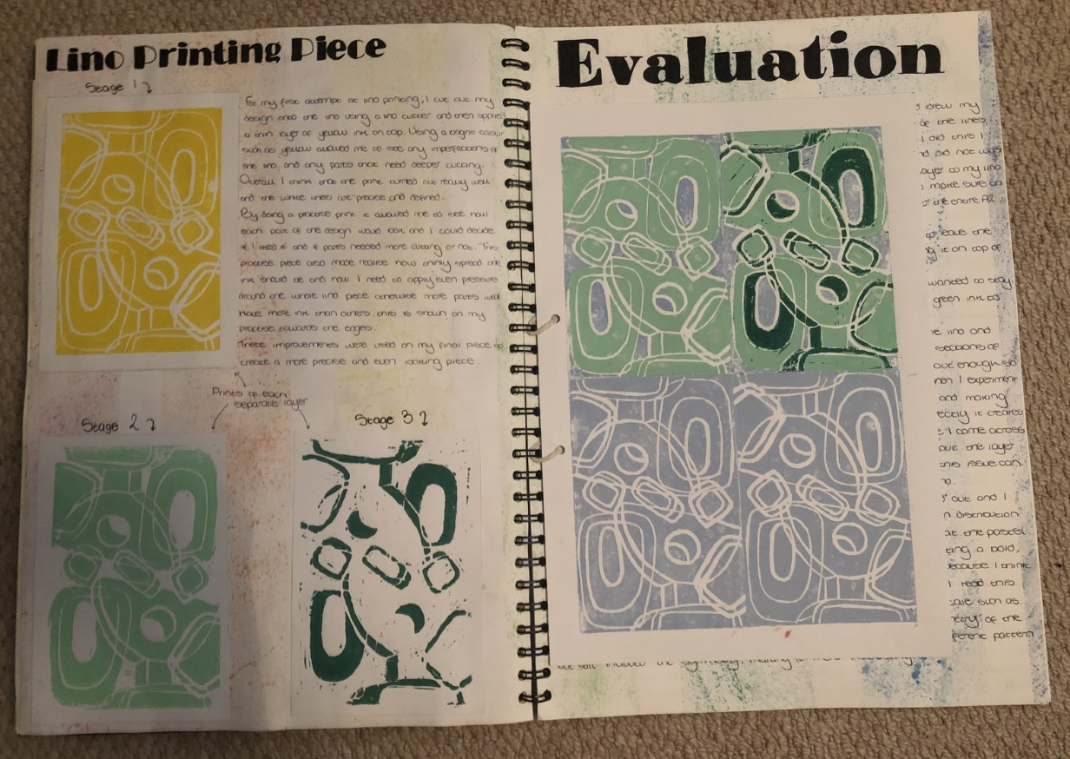
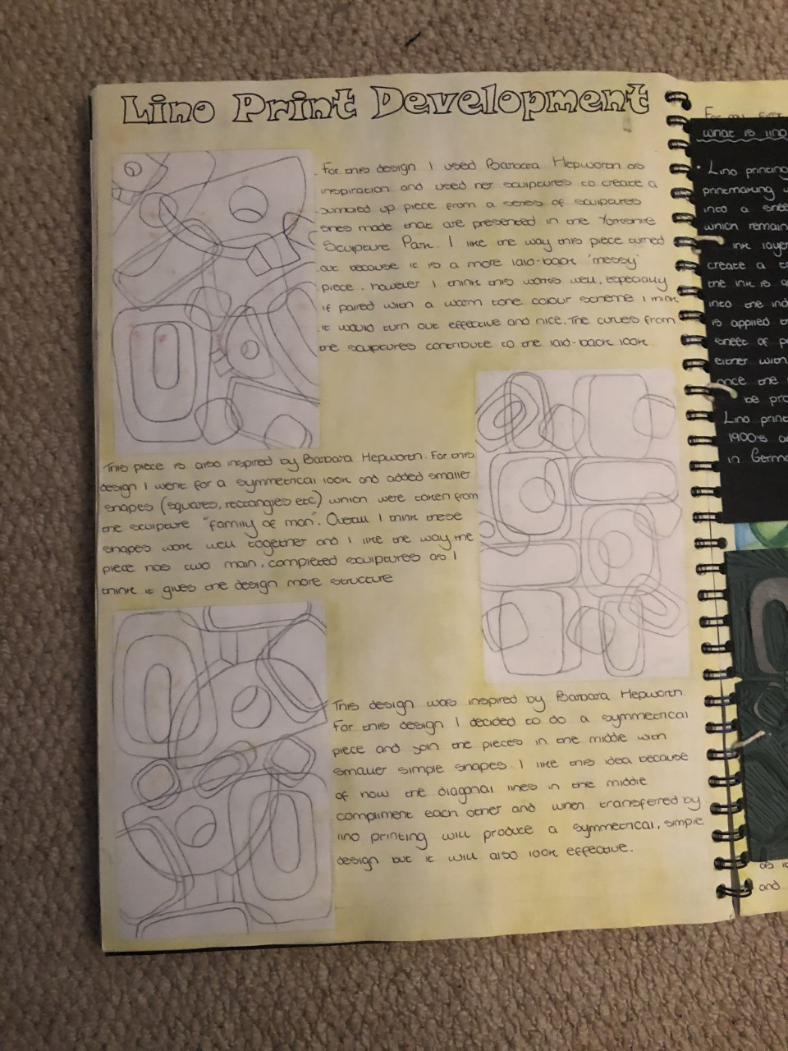
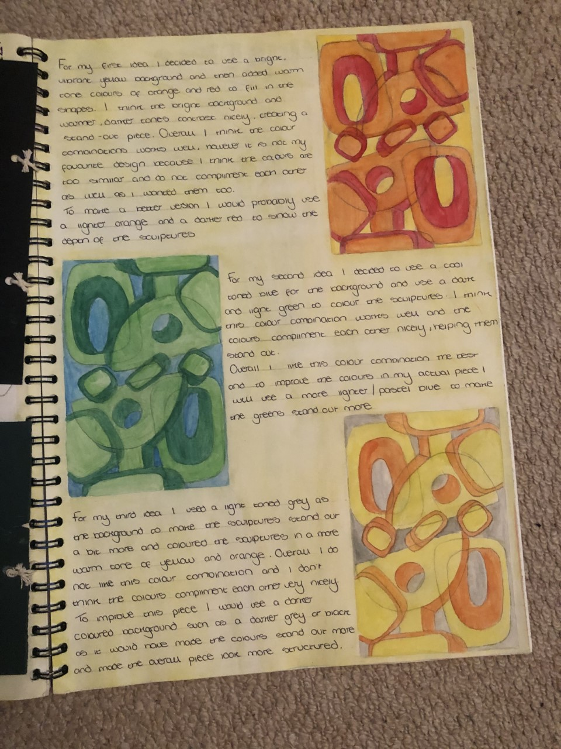
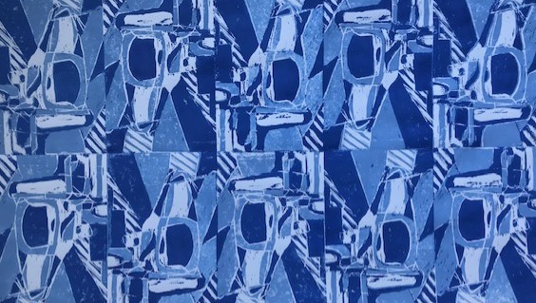
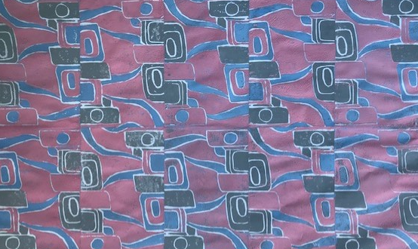
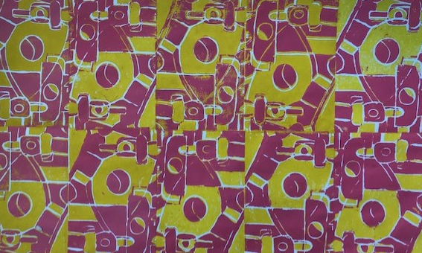
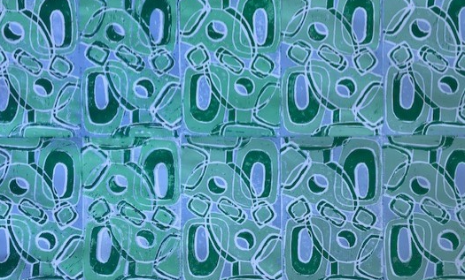
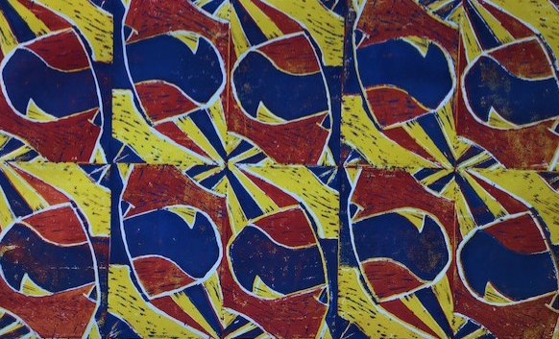
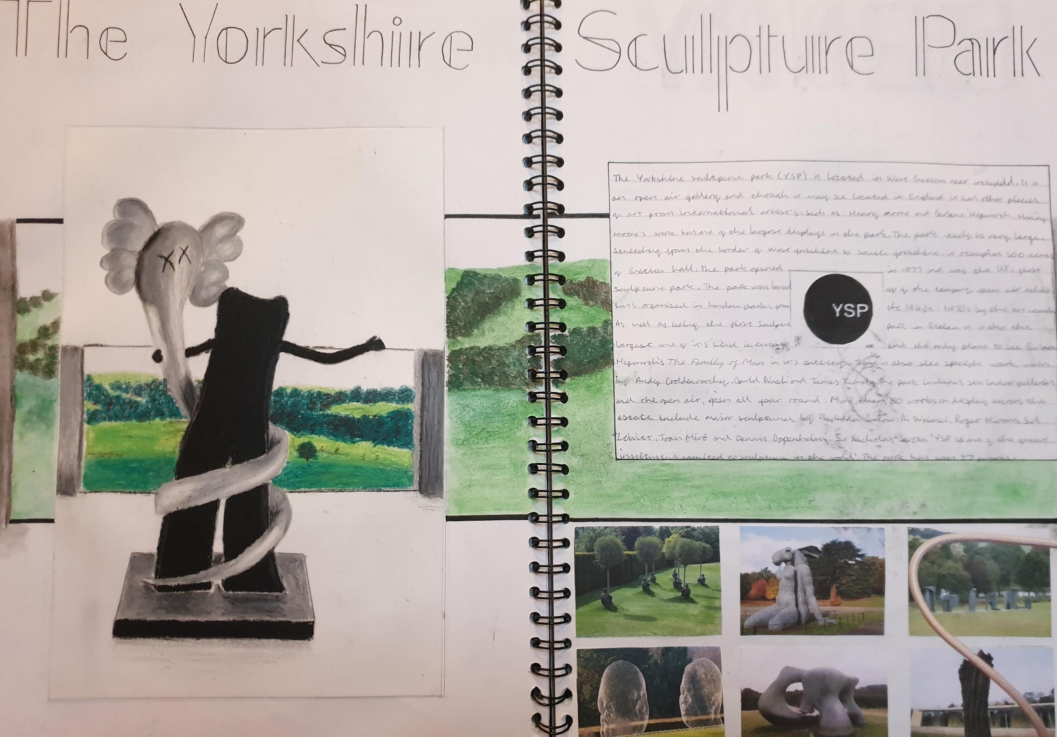
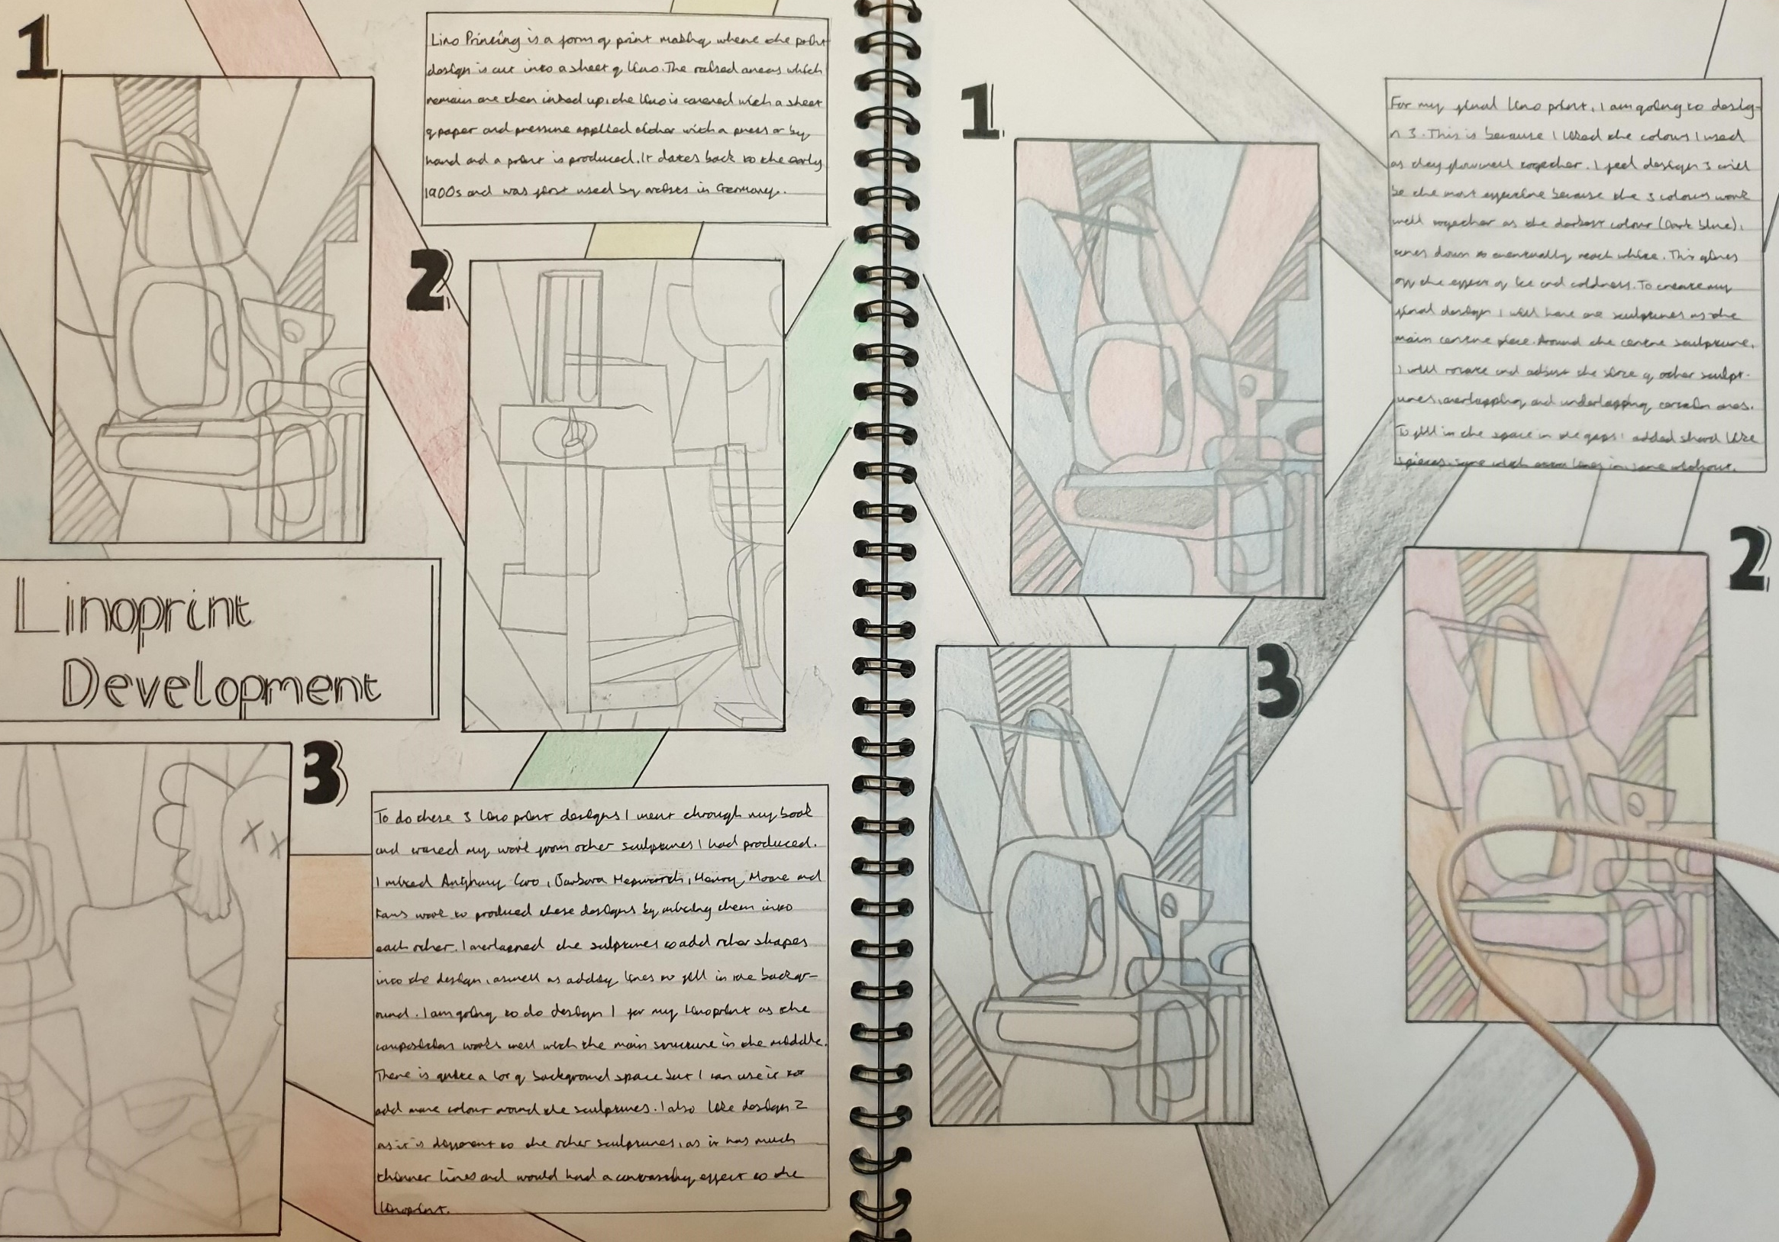
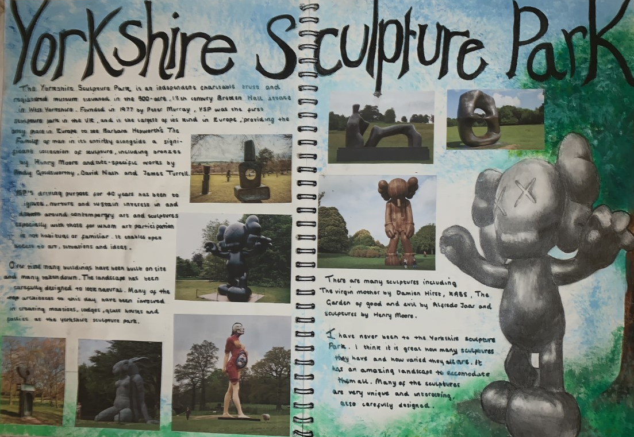
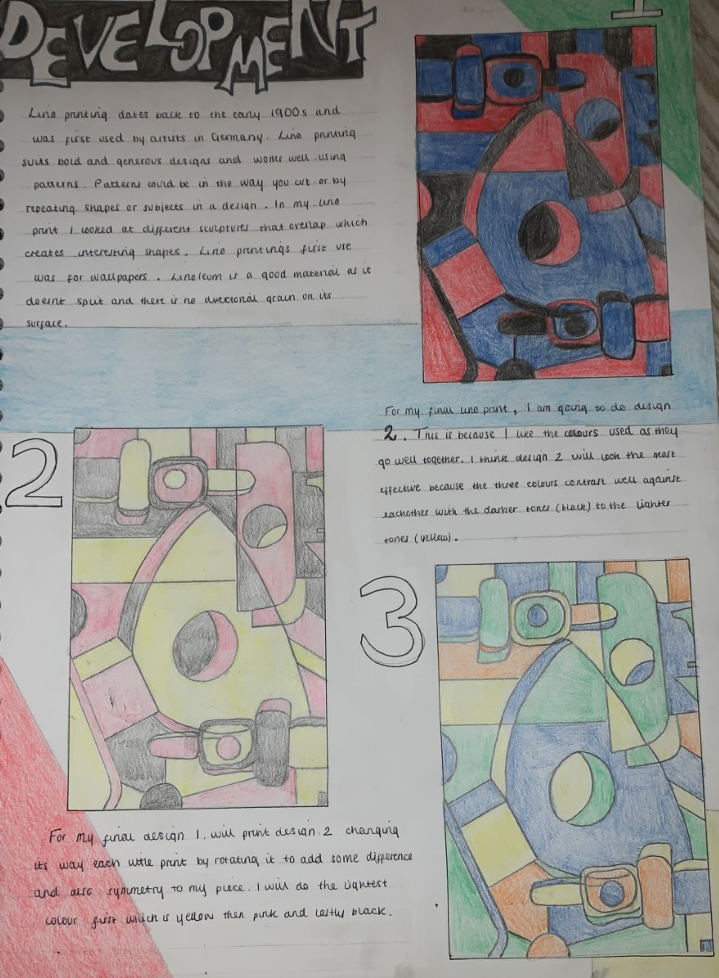
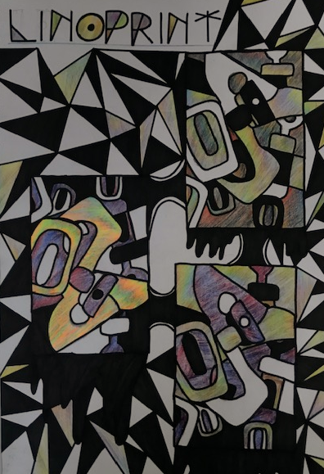
PERSONAL PORTFOLIO – TOPIC 1 YSP

Slide 4
PERSONAL PORTFOLIO – TOPIC 1 YSP
The course runs over two years and starts with a visit to the Yorkshire Sculpture Park at the beginning of Year 10. During this visit students will look at a range of artists work such as Henry Moore, Barbara Hepworth and Anthony Caro. Once back in school we will use this work to produce a series of experimental pieces using different drawing techniques, 3D sculpture and lino printing. Students are encouraged to also find an artist of their own during the trip who particularly inspires them.

Slide 5
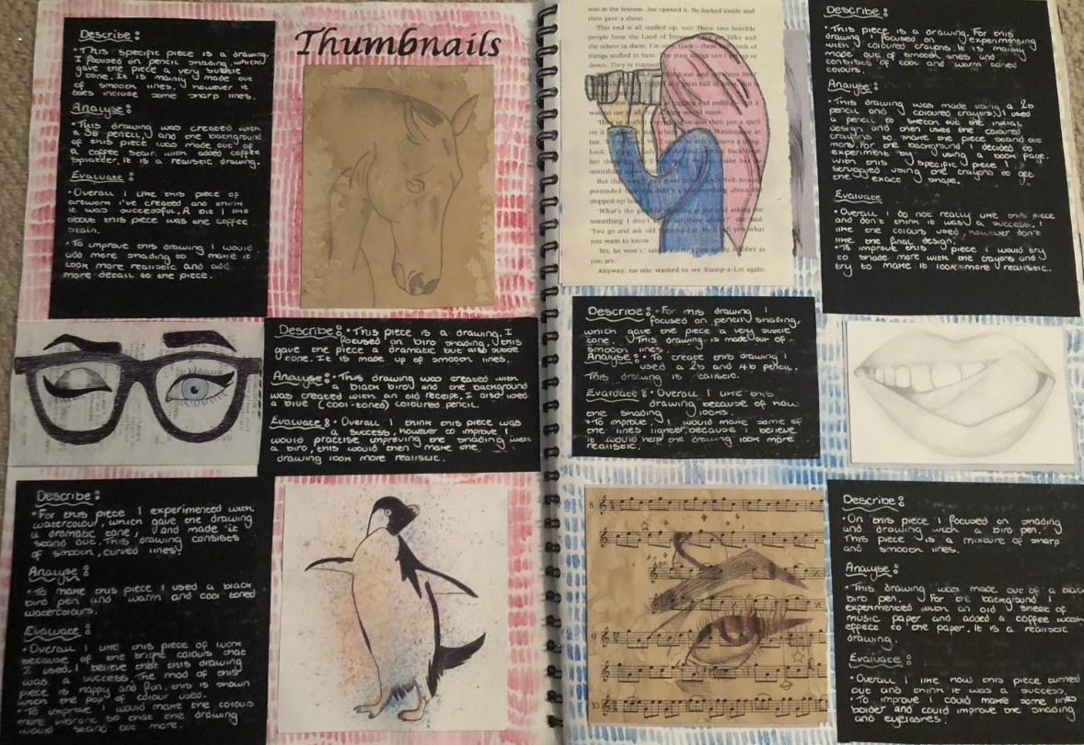
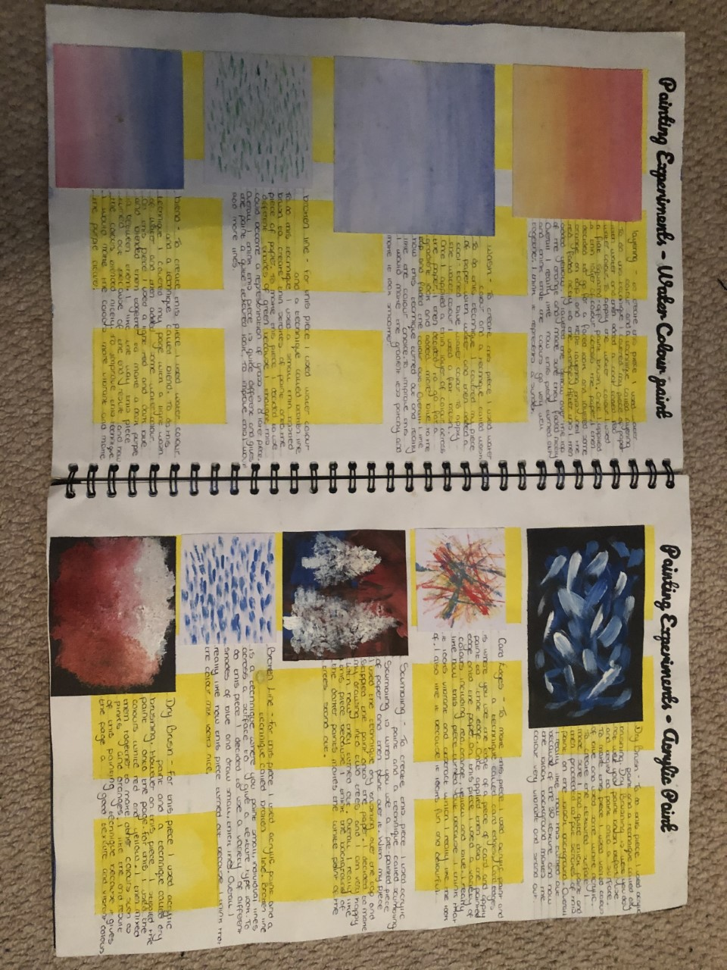
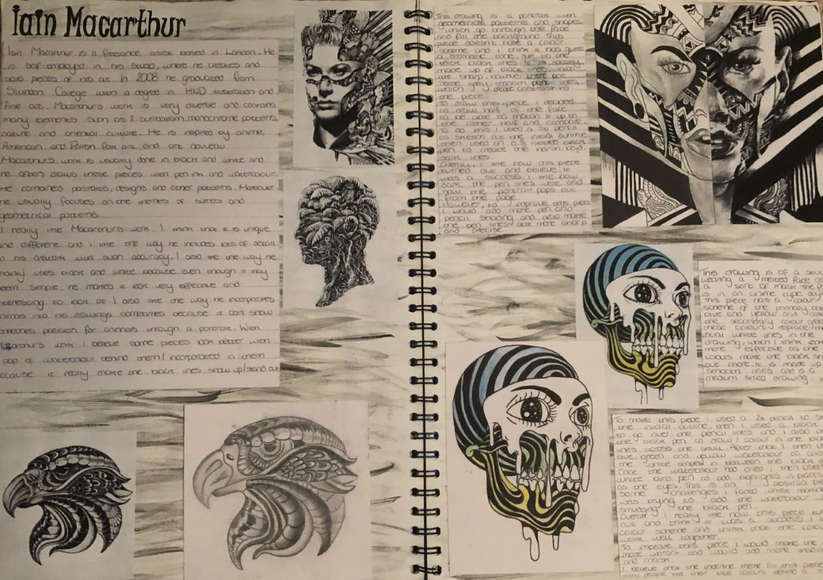
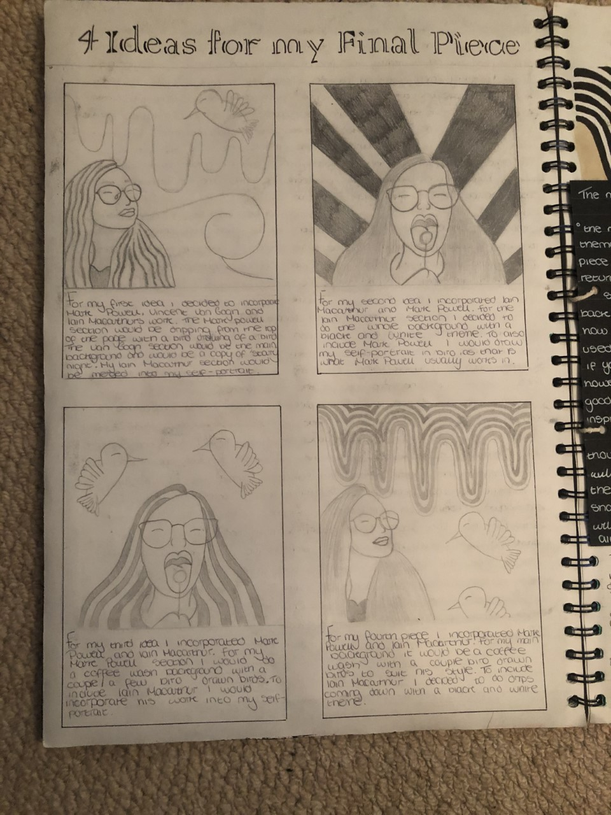
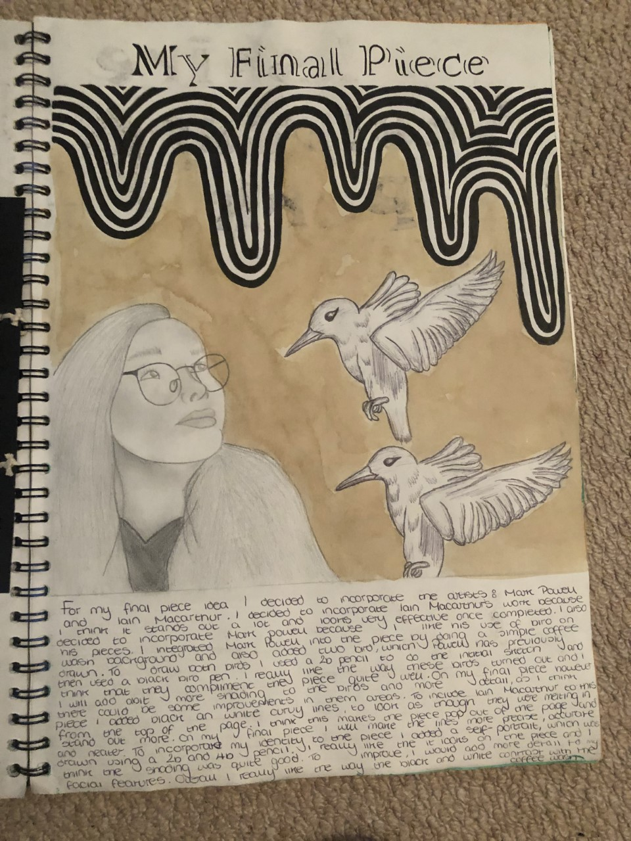
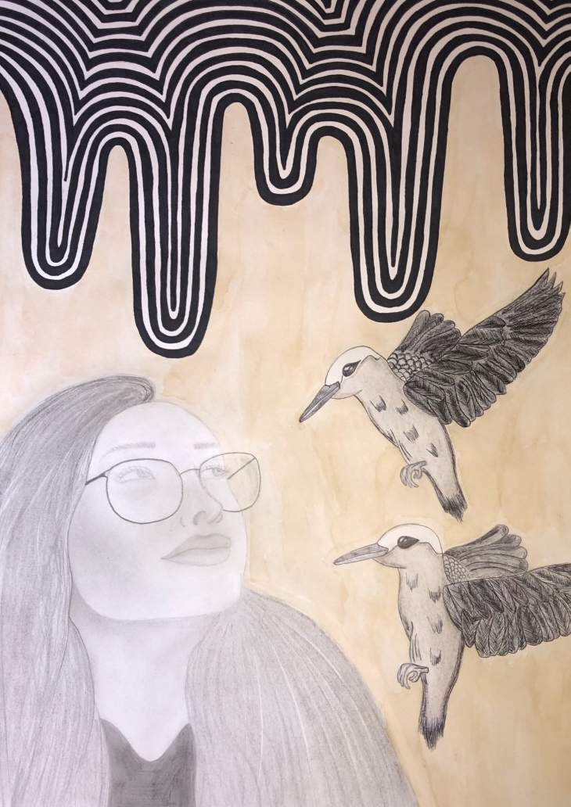
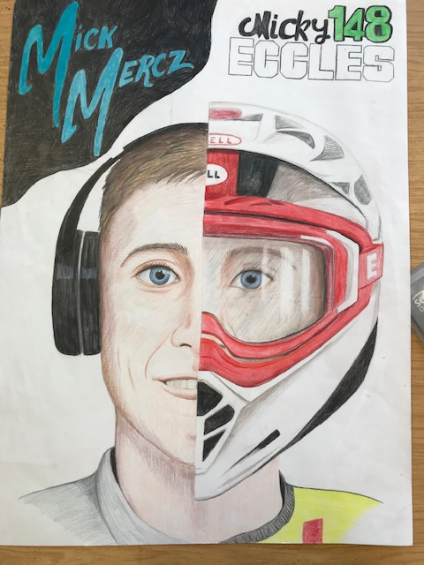
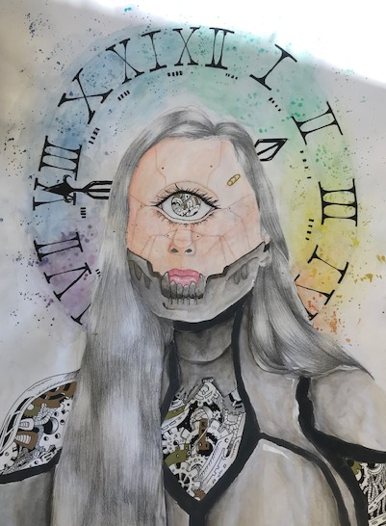
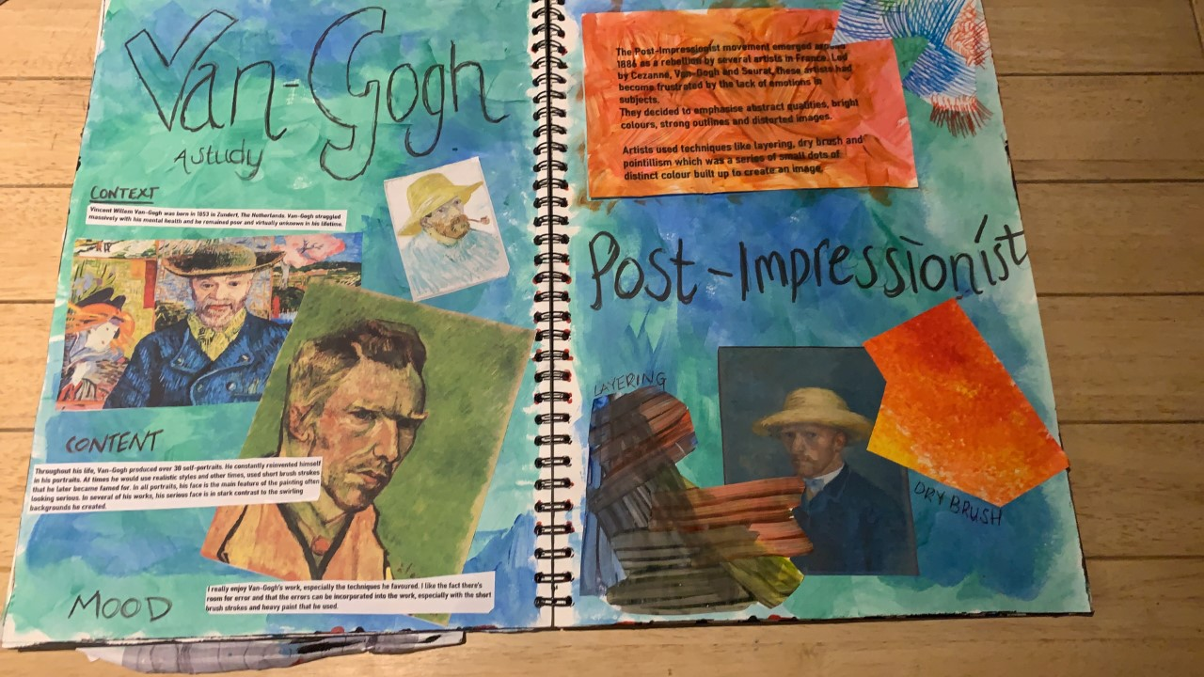
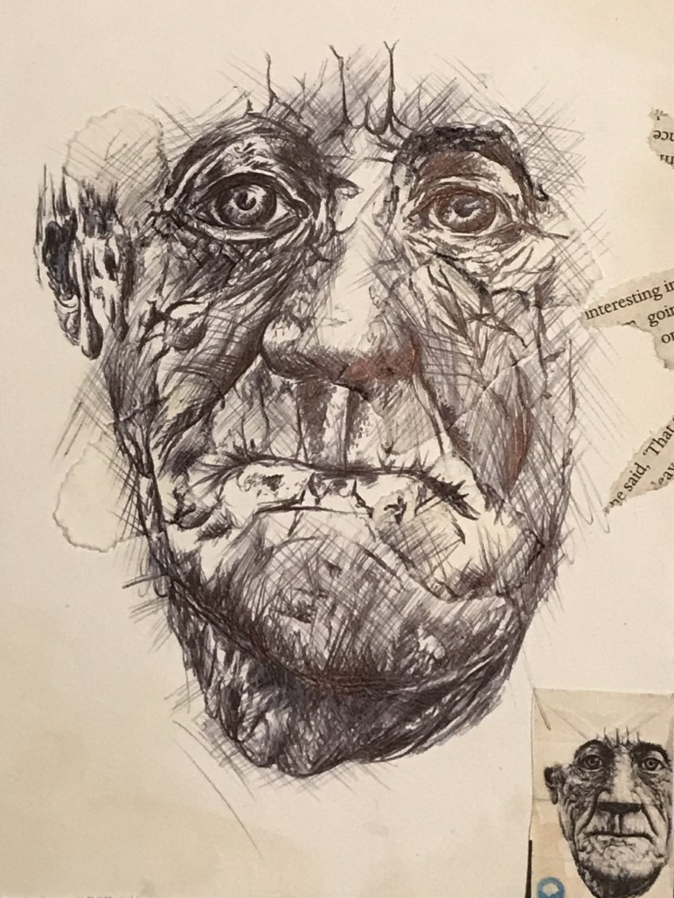
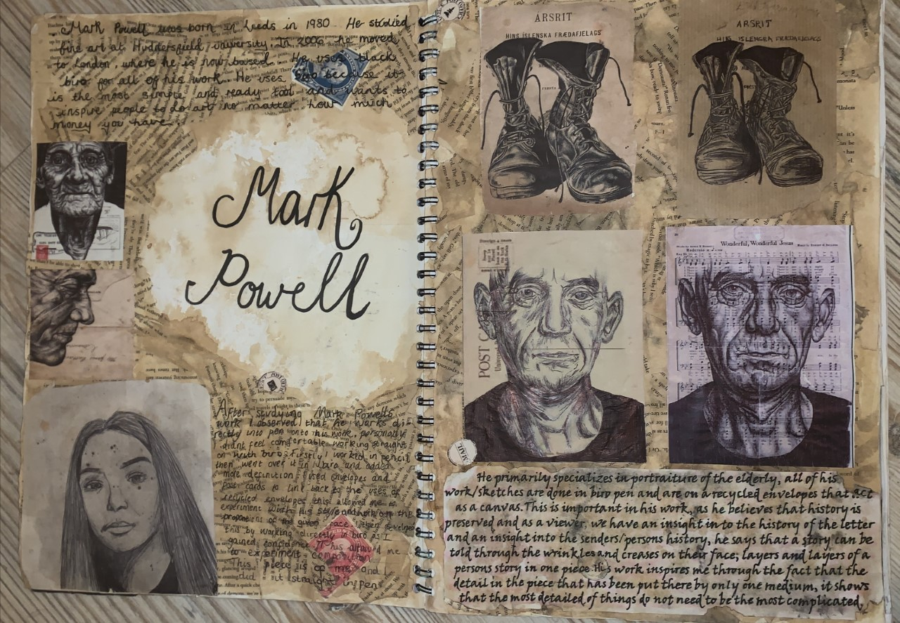
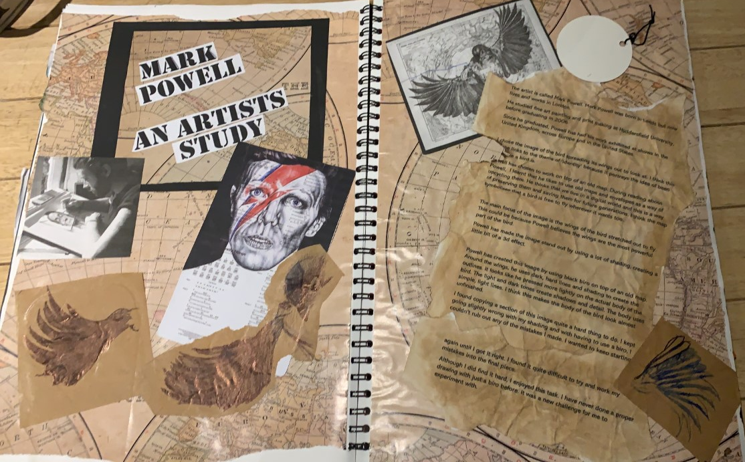
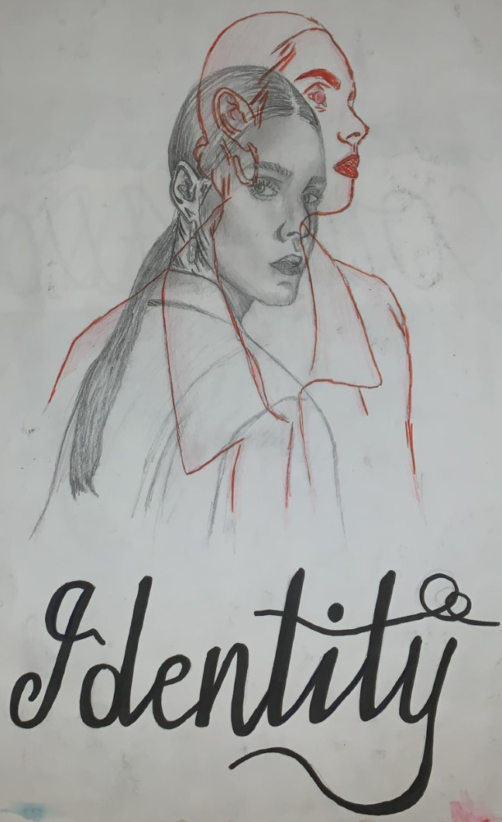
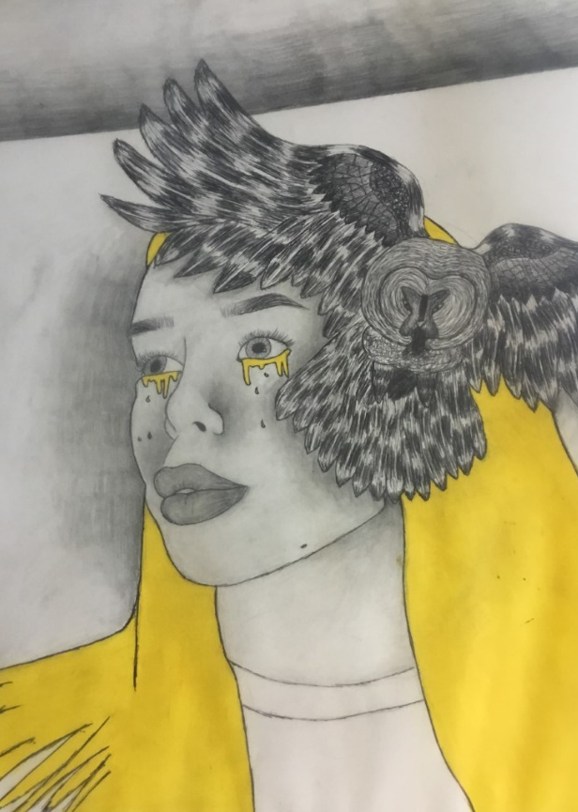
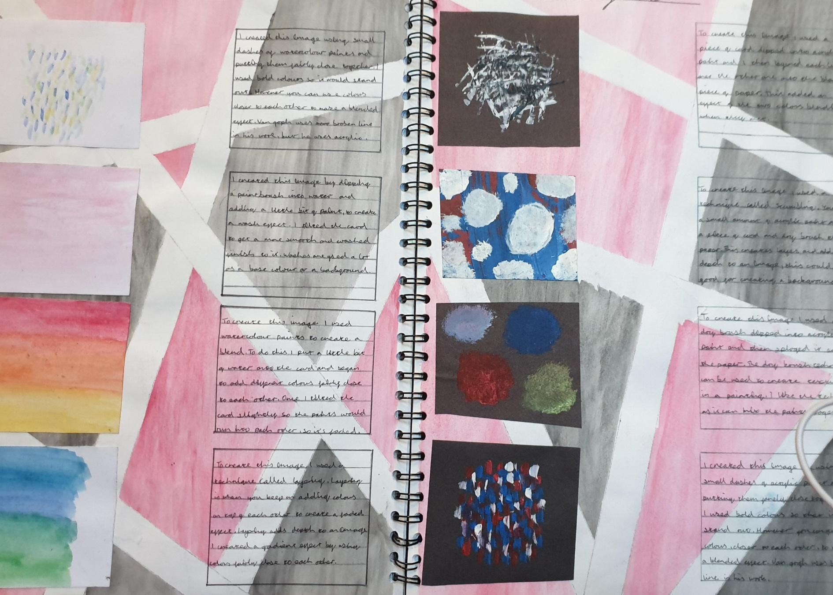
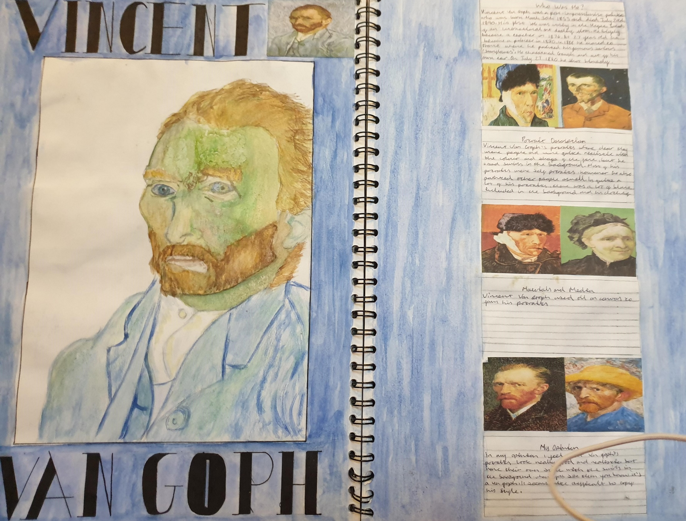
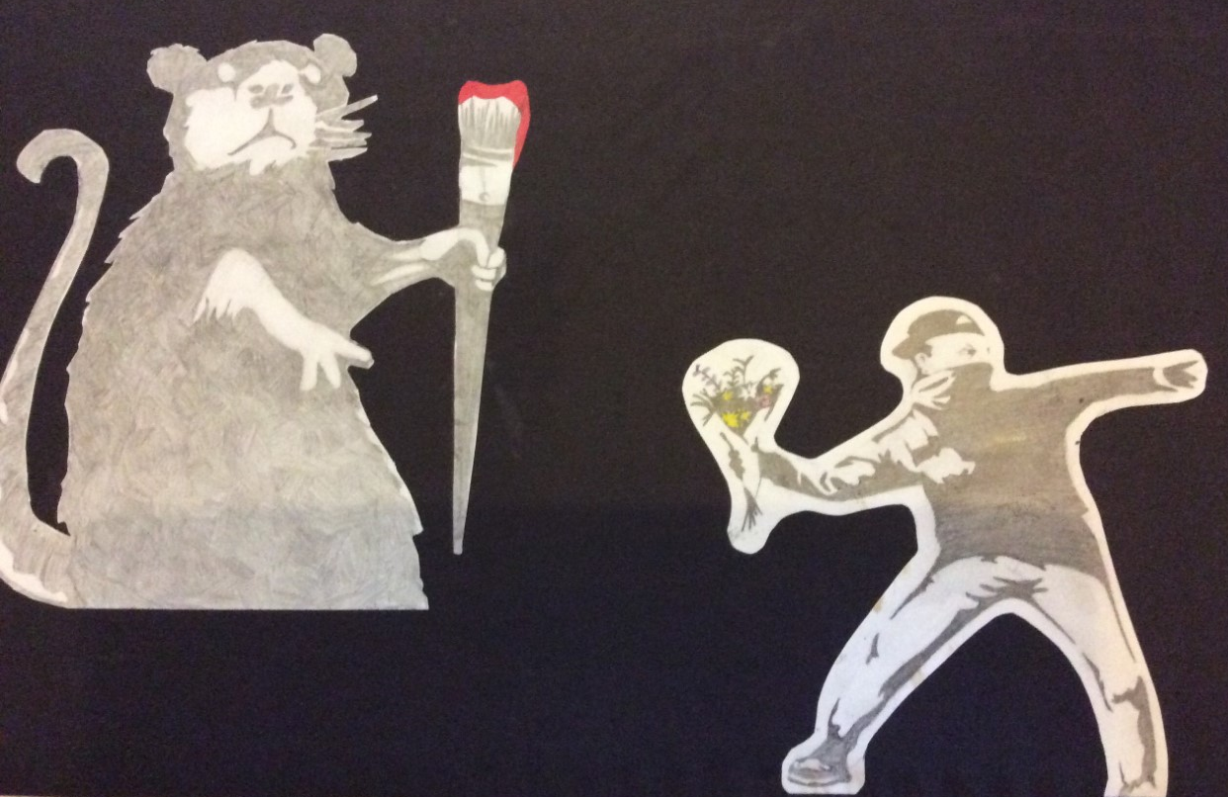
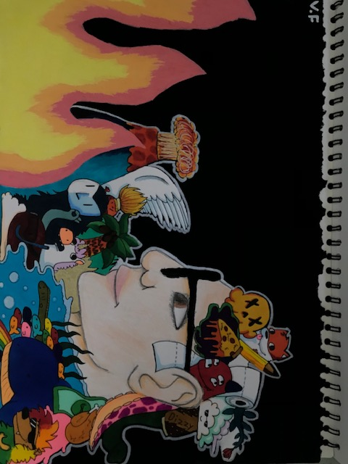
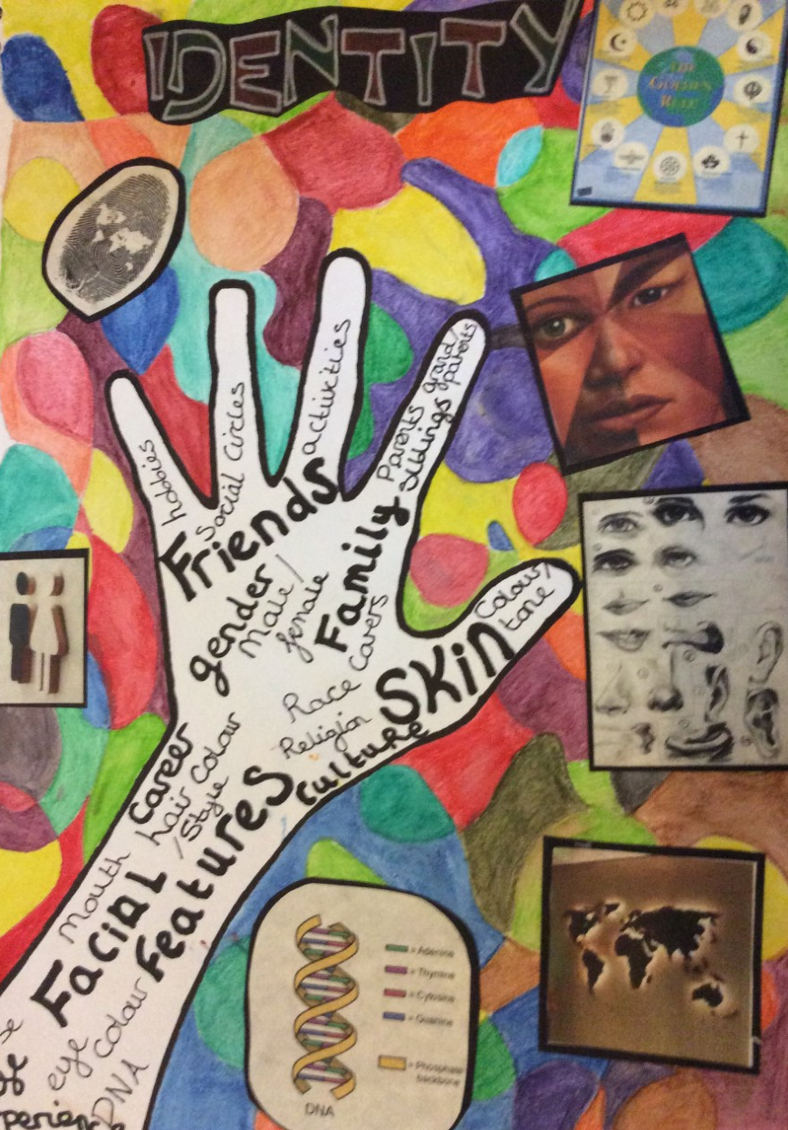
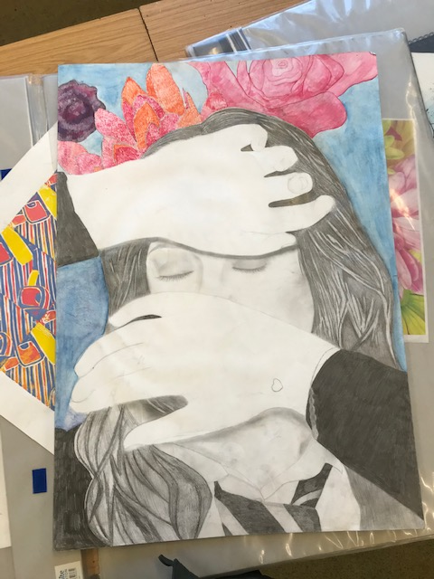
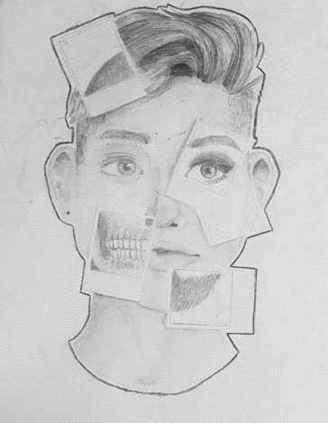
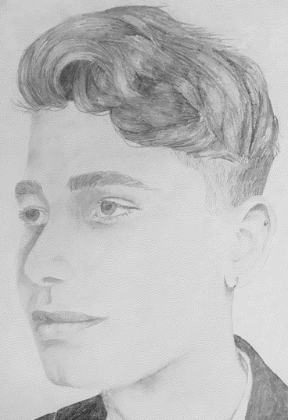
PERSONAL PORTFOLIO – TOPIC 2 IDENTITY

Slide 6
PERSONAL PORTFOLIO – TOPIC 2 IDENTITY
The second unit of work follows the theme of “Identity” and gives students the chance to be more independent in their work and build upon the skills taught in the first unit. Students will develop a range of work in response to this theme leading to a series of final outcomes.

Slide 7
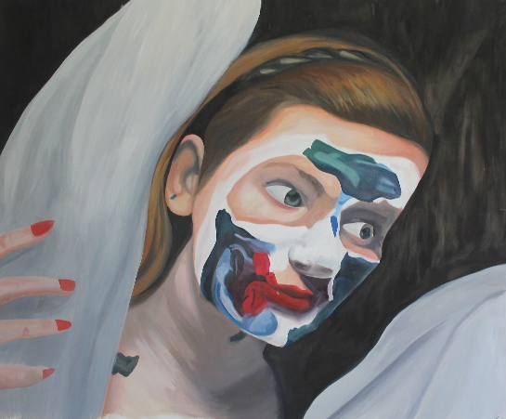
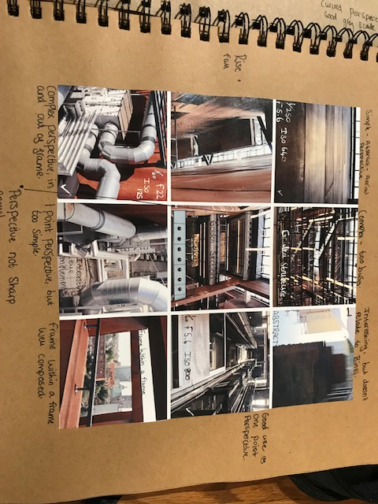
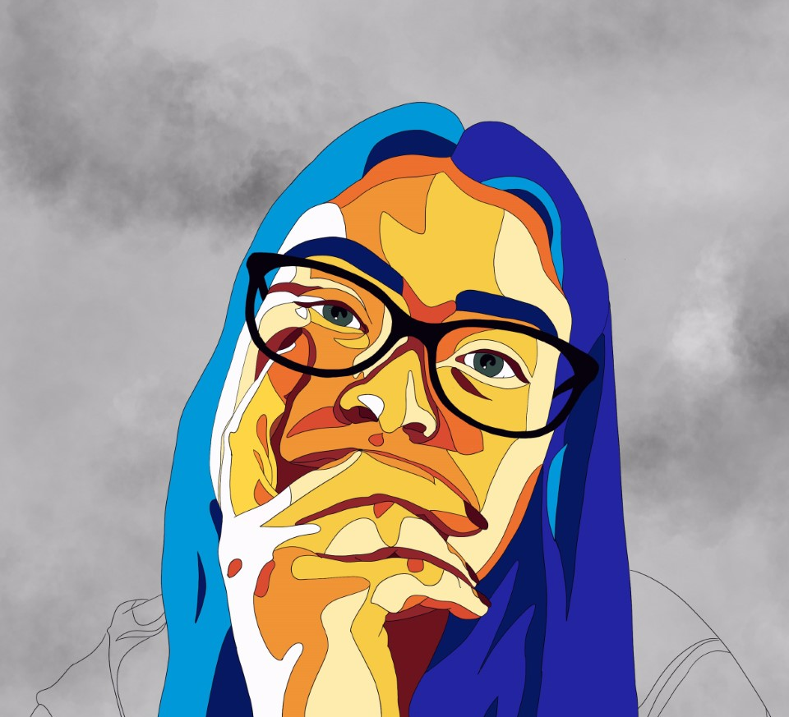
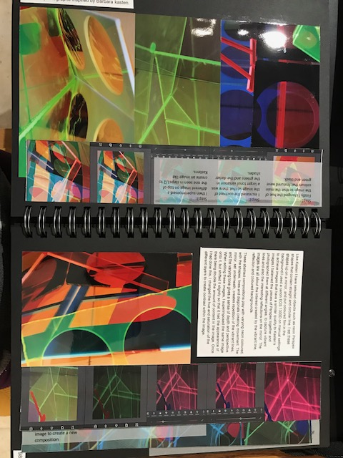
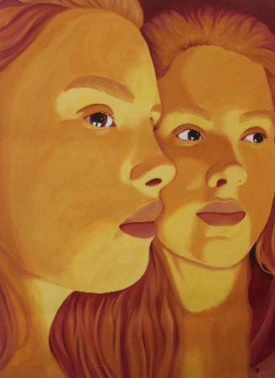
PROGRESSION
“I chose GCSE art because it allowed more freedom in managing my work and I wanted to further develop my creative skills. During GCSE I was introduced to new techniques and artists that I have gone on to study further in my A’ level work. Art is my favourite subject and I really enjoy being able to express myself in a visual way and I have now been given an offer from Leeds Arts University to do an art foundation year, after which I intend to go on to study Fine Art at university.”
Megan, Year 13
A’ Level Art (AQA Art, Craft and Design)
A’ Level Photography (AQA)
Other college-based creative courses
The creative industries are one of Britain’s most successful industries.
If a student wants to be part of, for example film, fashion, advertising, architecture, fine art, photography, design or publishing it starts here!
Examples of A’Level work

Slide 8
ASSESSMENT
This is very much on an individual basis with verbal 1:1 feedback given each lesson
Formal assessment will be carried out at each of the assessment points throughout the year
Each project will be formally marked as a whole, with an assessment sheet explaining your strengths and areas for development
Personal Portfolio (120 guided learning hours) = 60%
Externally Set Assignment (Exam - 10 hours over 2 days, with 20 hours approx. for prep) = 40%

Slide 9
WHAT DO OUR STUDENTS SAY?
“Art is a good subject to take at GCSE level. It’s interesting and you get lots of support to develop your own art.” Jack, Year 10
“I think the best part about the art GCSE course is the freedom we receive with what we’re doing so no two peoples books will look the same and how art is subjective so you don’t necessarily need to be the best at it.” Laura, year 10
“The best part about GCSE art is that you can be really creative and put your emotions/feelings into a piece of art. You are also very free with what you draw and how you present your book.” Amber Year 11
“The best thing about GCSE art is how creative you can be. You also get to try out using different materials and media like Lino printing and clay.” Olivia, year 11

Slide 10
WHAT DO OUR STUDENTS SAY?
“The best part of the GCSE course is that you really get to tap into your creative side which is wonderful because it challenges your mind and let’s you express yourself on paper. It’s also very informative as you get to learn about different artists, their backstories and see their beautiful artwork. You also have a lot of freedom with how you create your work and you can make it look however you feel it should which makes it even better as it’s personal to you and how you do things.” Elena, Year 10
“I really enjoy GCSE art and I am so glad I chose to take it. I love the work that has been chosen by teachers because it’s always something new but there is always a sense of freedom and being able to add in your own ideas and be creative. It is interesting and fun to try new media and develop your work in different new ways.” Olivia, Year 11
“Art is a very fun lesson, that gives you a break from any stress, there seems like quite a lot of work but it’s alright if you keep on top of it” Matthew, year 11
Please contact: jenny.fenwick@thirskschool.org
should you require any additional information

